Slide 1
A preliminary exploration on positive psychological traits associated with the recovery from opioid addiction
by comparing tweets of opioid-addicted users
and the tweets of opioid-recovered users
Zhuozhuo Liu · 05/13/2022

Slide 2
Problem

Slide 3
Psychological traits associated with recovery
Self-efficacy: an individual's belief in his or her capacity to execute behaviors necessary to produce specific performance attainments (Bandura, 1977, 1986, 1997).
Self-control: delayed gratification.
Coping strategy: positive thinking, seeking support, etc.
Other positive: optimism, spirituality and religiosity.
Marlatt GA, Donovan DM. Relapse Prevention: Maintenance Strategies in the Treatment of Addictive Behaviors. New York: Guilford Press; 2005.
A’VERRIA SIRKIN MARTIN, P. H. D., HARMELL, A., & MAUSBACH, B. T. (2015). Positive psychological traits. Positive psychiatry: A clinical handbook, 19.

Slide 4
Hypothesis
Question: Is there any difference between any tweet posted by 2 groups (not limited to opioid related tweets)?
Recovered people may tweet in a more psychologically positive way.
Addicted users:
currently addicted to opioid
Recovered users:
clean and recovered from a previous opioid addiction

Slide 5
Data Collection

Slide 6
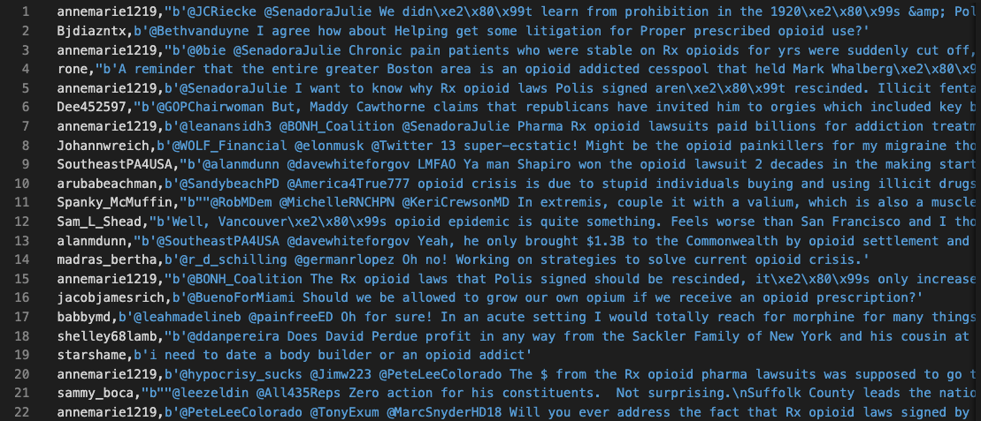
Fetch opioid-related tweets
(33407 tweets) Used Tweepy to query tweets containing drug_keywords posted in 4/19/2022 - 4/25/2022.
Keywords:
drug_keywords = ["opioid", "codeine", "heroin", "demerol", "dilaudid", "percocet", "fentanyl"]
drug_keywords_variants = ["codine", "herion", "heroine", "demeral", "dilauded", "dilaudud", "dulaudid", "percs", "percocets", "percoset", "fentyl"]

Slide 7
2. Annotate addicted tweets and recovered tweets
Reviewed ~8,000 tweets in total.
Found 88 addiction-indicating tweets.
“i used to be the biggest pothead. but now it gives me anxiety so i do heroin'”
Found 112 recovery-indicating tweets.
I was a heroin addict and lost my bf to an overdose. Now I\xe2\x80\x99m clean and sober and pursuing my dream.
Had another person reviewed addiction-indicating tweets on Mechanical Turk.
So far we have:
(87 users) Addicted_users = [user1, user2, user3…]
(111 users) Recovered_users = [user4, user5, user6,...]

Slide 8
3. Fetch users’ timeline
Fetched the latest 100 tweets of each user in addicted_user and recovered_user.
It can be either an original tweet or a reply (no retweets).
It can be either an opioid-related tweet or a non-opioid-related tweet.
So far we have:
(6323 tweets) Tweets_of_addicted_users = [tweet_object1, tweet_object2, …]
(7960 tweets) Tweets_of_recovered_users = [tweet_object3, tweet_object4, …]

Slide 9
Analysis & Results

Slide 10
User-level analysis
group tweets by users and compare users between two groups

Slide 11
Pos/Neg sentiment score
User-level Analysis
A VADER output example:
“Today only kinda sux! But I'll get by, lol”-------- {'pos': 0.317, 'compound': 0.5249, 'neu': 0.556, 'neg': 0.127}
Calculated pos, neg and compound score for every tweet using VADER.
Grouped tweets by users and calculated mean pos, neg and compound scores for each user.
So far we have 2 of the following dict for 2 groups:
{user1: {“pos”: 0.7, “neg”: “0.1”, “compound”: 0.1},
user2: {“pos”: 0.2, “neg”: “0.4”, “compound”: -0.1},
…}

Slide 12
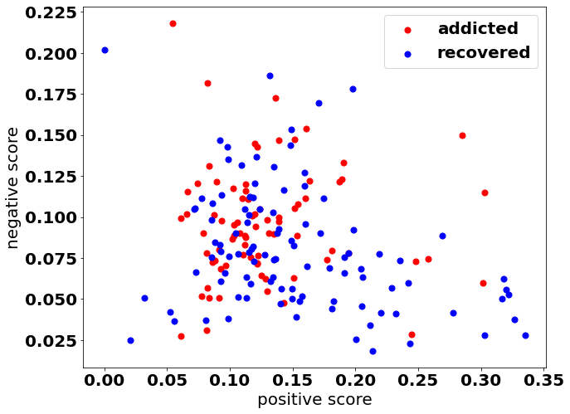
Pos/Neg sentiment score
User-level Analysis
Each dot represents a user (X, Y) where:
X = positive score
Y = negative score
Recovered group seems have larger positive sentiment scores.

Slide 13
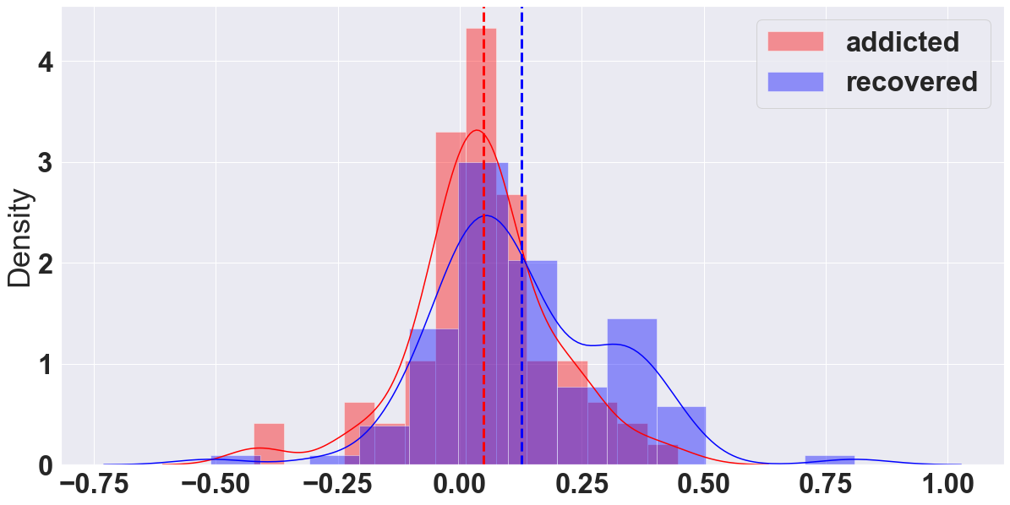
Compare compound sentiment score
User-level Analysis
positive sentiment : >= 0.05
neutral sentiment : > -0.05 and < 0.05
negative sentiment : <= -0.05
This is the distribution of compound score.
Statistics=-3.072, p=0.002
The sentiment of the recovered group is significantly more positive than the sentiment of the addicted group.

Slide 14
Text-level analysis
aggregate tweets within the same group and compare texts between two groups

Slide 15
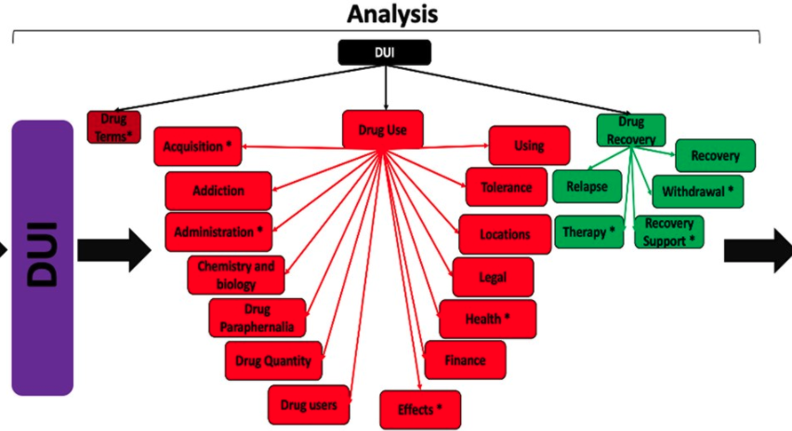
DUI lexicon
Word-level Analysis
3 categories: drug_term, drug_use, drug_recovery

Slide 16
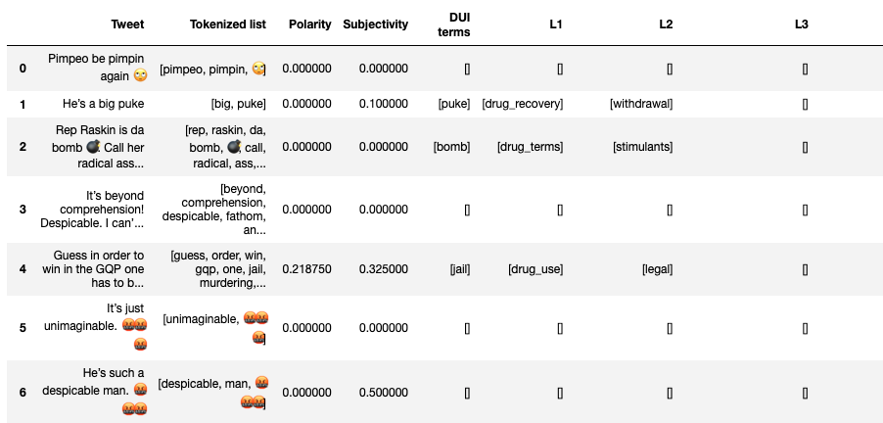
Frequency of DUI lexicon
Word-level Analysis

Slide 17
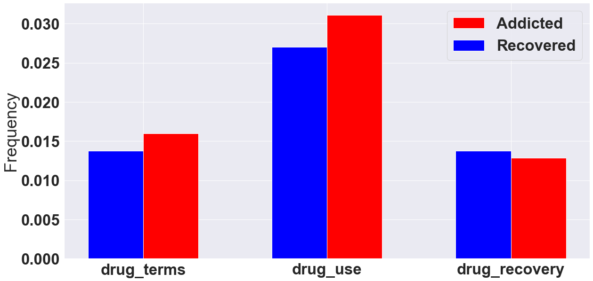
Compare DUI lexicon usage
Word-level Analysis
We calculated how frequent words in DUI L1 categories appear in all the tweets.
Frequency =
# terms in a category
/ # total terms
E.g., 2183 / 70229
Addicted group used words on drug terms and drug use more frequently.

Slide 18
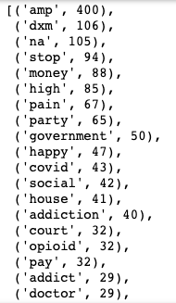
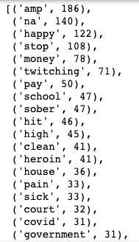
Top k terms
Word-level Analysis
Same word, same meaning?
Addicted group
Recovered group

Slide 19
Word2vec
Word-level Analysis
Got 2 word embedding models on 2 groups
PCA: reduce dimension for visualizing clusters

Slide 20
Explore attitude to hardship
Word-level Analysis
Did people develop any new interpretation on hardship/difficulty/pain after clean/recovered?
Defined a list of terms related to difficulties and positive attitudes:
hardship_terms = ['misery', 'distress', 'problem', 'hard', 'suffering', 'hurt', 'high', 'grateful', 'thank', 'appreciate' 'glad', 'hope', 'wish', 'difficult', 'difficulty', 'love', 'happy', 'death', 'die', 'dying']

Slide 21
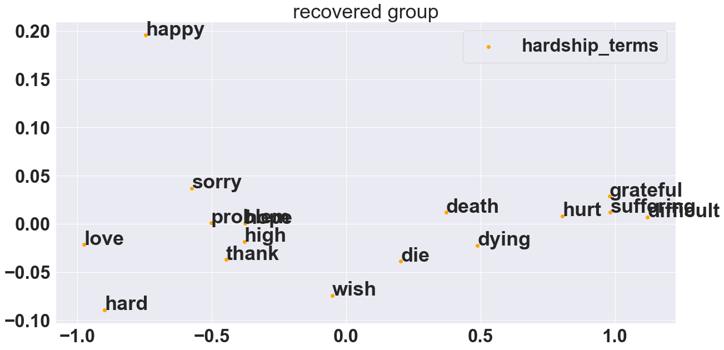
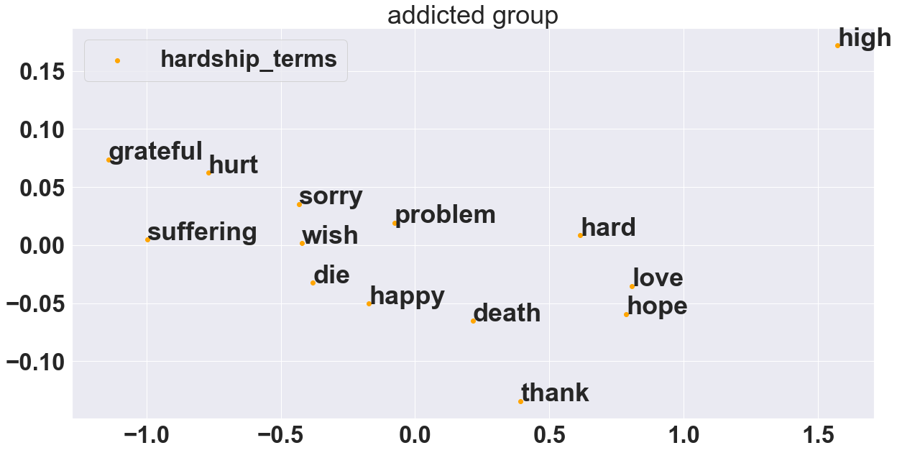
Explore attitude to hardship
Word-level Analysis

Slide 22
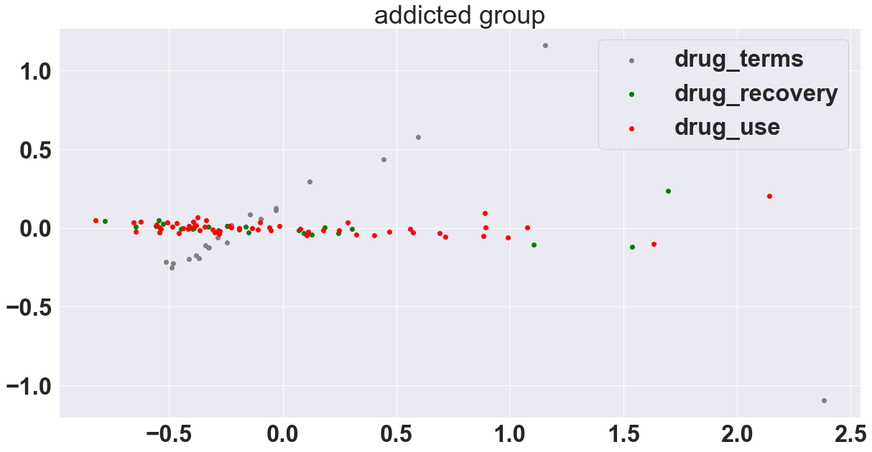
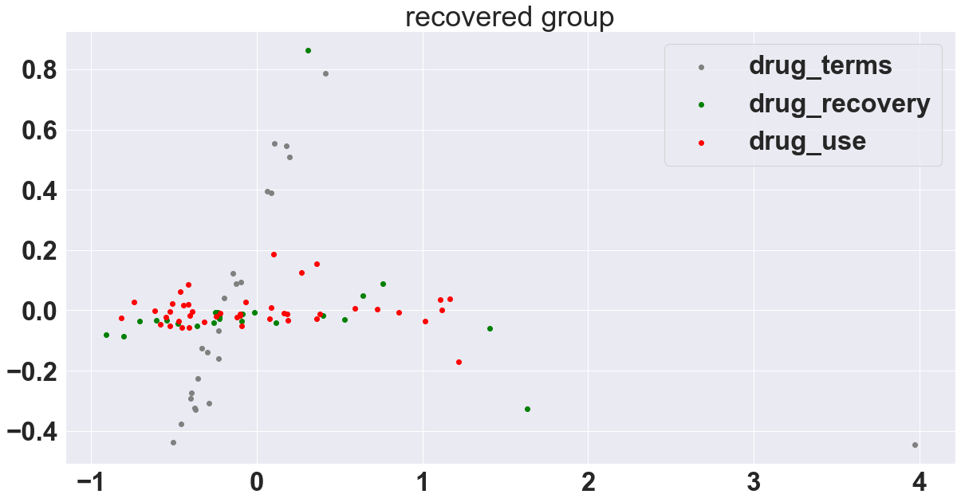
3 categories of DUI
Word-level Analysis

Slide 23
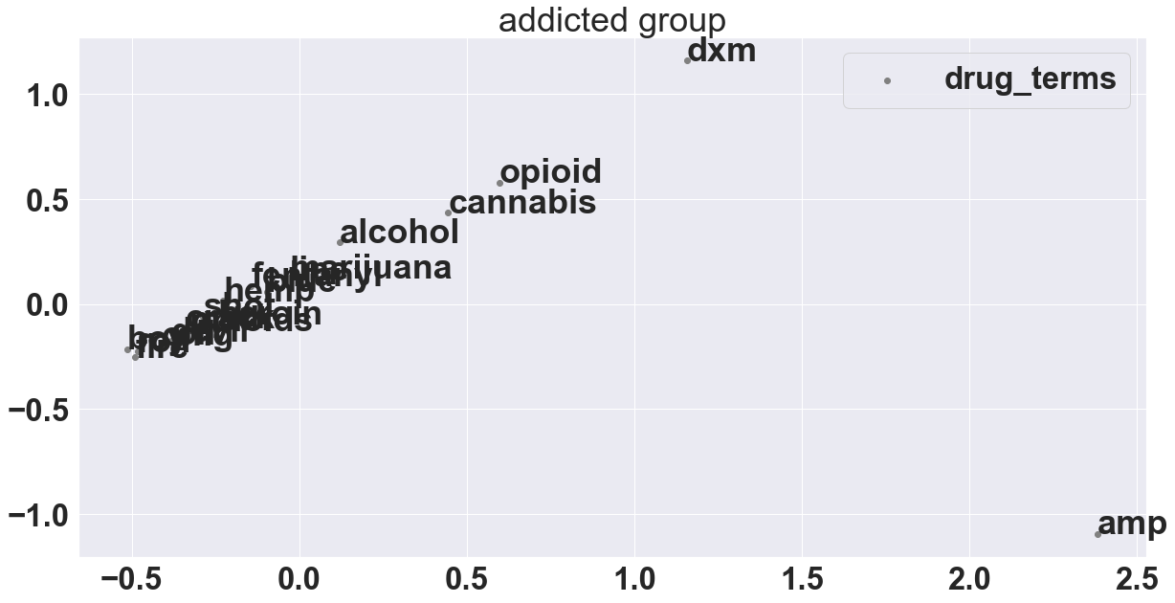
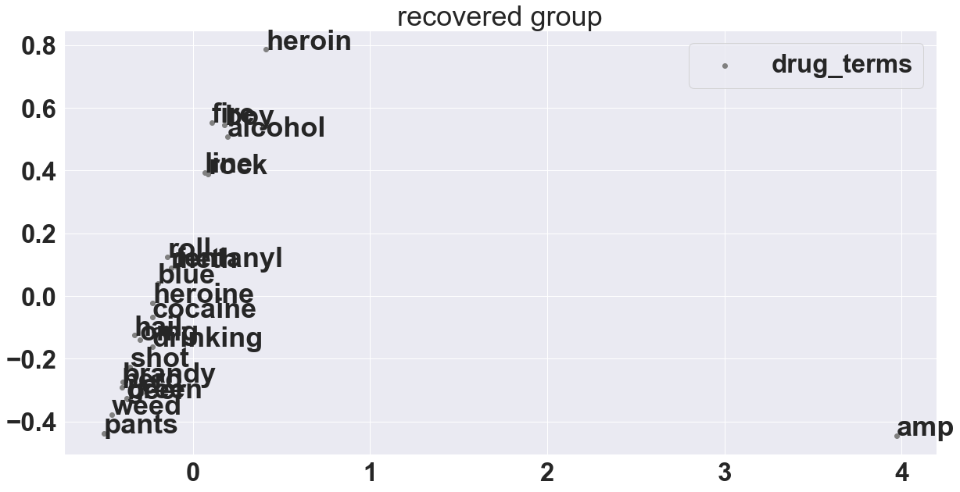
Drug terms
Word-level Analysis
Amp and dxm are clustered differently.
Amp should be removed earlier since it’s ampersand (&amp).

Slide 24
Conclusion
Found a significant difference on sentiments of regular tweets between the recovered group and the addicted group.
Further work:
if recovered group developed any new interpretation on hardship/difficulty/pain? Need to find interesting words.
Remove &amp and rebuild word embeddings.
https://www.mayoclinic.org/diseases-conditions/prescription-drug-abuse/in-depth/how-opioid-addiction-occurs/art-20360372

